Slide 1




Welcome!
Parenting Resources for Children and Adolescents in Yamhill County
Sponsored by:
C
C
C

Slide 2
Who we are
Chehalem Counseling Center
C
C
C
A program of Chehalem Youth and Family Services

Slide 3
Chehalem Counseling Center Programs
Child, Adolescent, Family, Couples, and Individual Counseling
  2 Licensed Psychologists, 4 QMHPS
  Reduced Sliding Scale for those who qualify
  Bill most major insurance plans
Medication Management
  Professional Mental Health Nurse Practitioner
  Patient Assistant Program
Assessments and Testing
Supervised Visitation/Exchanges

Slide 4
How to refer to Chehalem Counseling Center?
Schedule an appointment by calling 503-538-4874 during regular business hours Monday to Friday 8:30am-5pm
501 E First St.
Newberg, OR 97132
Phone: 503-538-4874
Fax: 503-538-1271
Email: reception@cyfs.net
www.chehalemcounseling.com

Slide 5






Youth Opportunity
A program of
Chehalem Youth & Family Services

Slide 6
YOOP – A RESOURCE FOR YOUTH
  JOB PREPERATION
  Job applications
  Building a better resume & writing cover letters
  Interview preparation
  Mock interviews with community members
  Job shadows & internships
  EDUCATIONAL SERVICES
  Tutoring
  Senior projects
  Computer training
  FAFSA & scholarship assistance
  College enrollment support
  Parenting classes

Slide 7
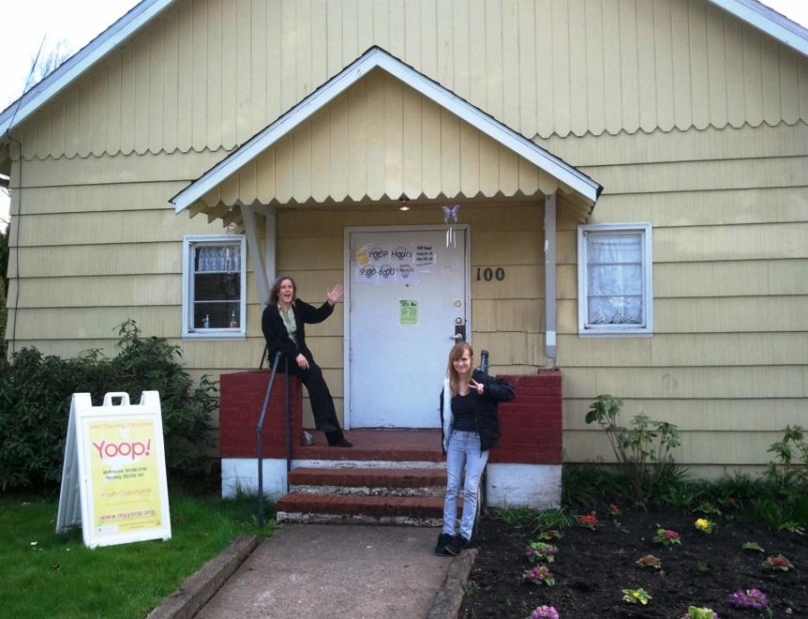

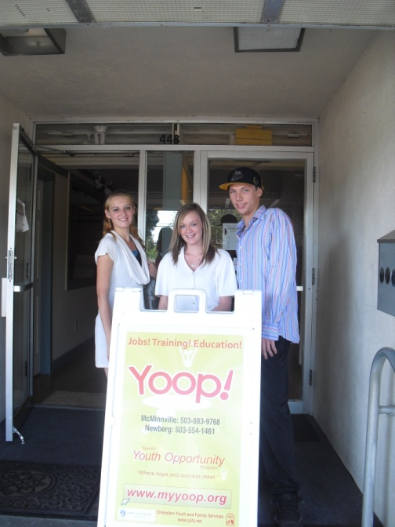
YOOP IN NEWBERG and MCMINNVILLE
100 E Fifth St
Newberg 97132
Phone 503-554-1461
Fax 503-538-1271
448 Third St. Suite M McMinnville 97128
Phone 503-883-9768
Fax 503-883-9773

Slide 8
Who we are
George Fox Behavioral Health Clinic
A program of:
Notes:
8

Slide 9
GFBHC Programs
Family, Couples, and Individual Counseling
  1 Licensed Psychologist, 5-10 Master’s level therapists
  Reduced Sliding Scale
  Vouchers for free treatment available from Love INC
  Treatment is short-term, solution, focused
  Parent skills training classes
Assessments and Testing
  Learning Disabilities
  ADHD
  IQ
  Emotional concerns

Slide 10
How to refer to GFBHC?
Schedule an appointment: telephone or email
Regular business hours Monday, Tuesday, Thursday 8:00am-5pm
501 Villa Ave.
Newberg, OR 97132
Phone: 503-554-2368
Fax: 503-554-2369
Email: gfbhc@georgefox.edu
www.georgefox.edu/psyd/clinic

Slide 11
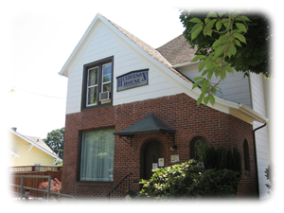
Henderson House
“Providing culturally aware outreach, education and services for victims of domestic and sexual violence through leadership in ending oppression.”

Slide 12

Programs & Support Groups
DV Support Group
Advanced DV Support Group
Getting Save & Sober
Teens DV Support Group
Children’s DV Support Group
Sexual Assault & Adults Molested as Children
Rural Outreach Programs available in Newberg & Willamina
Hispanic Outreach Programs
Henderson House
provides safety, shelter and services that enable women and children to escape and recover from domestic violence or sexual assault. We work to change the conditions in our society that lead to oppression and violence against our most vulnerable neighbors, through direct services, education and outreach.

Slide 13

24 Hour Crisis Line
503-472-1503
First 610 SE Street
McMinnville, OR 97128
Mon-Fri 9:00-5:00 lburrows@hendersonhouse.org

Slide 14

Love In the Name of Christ (Love INC)
Helping Churches help People

Slide 15
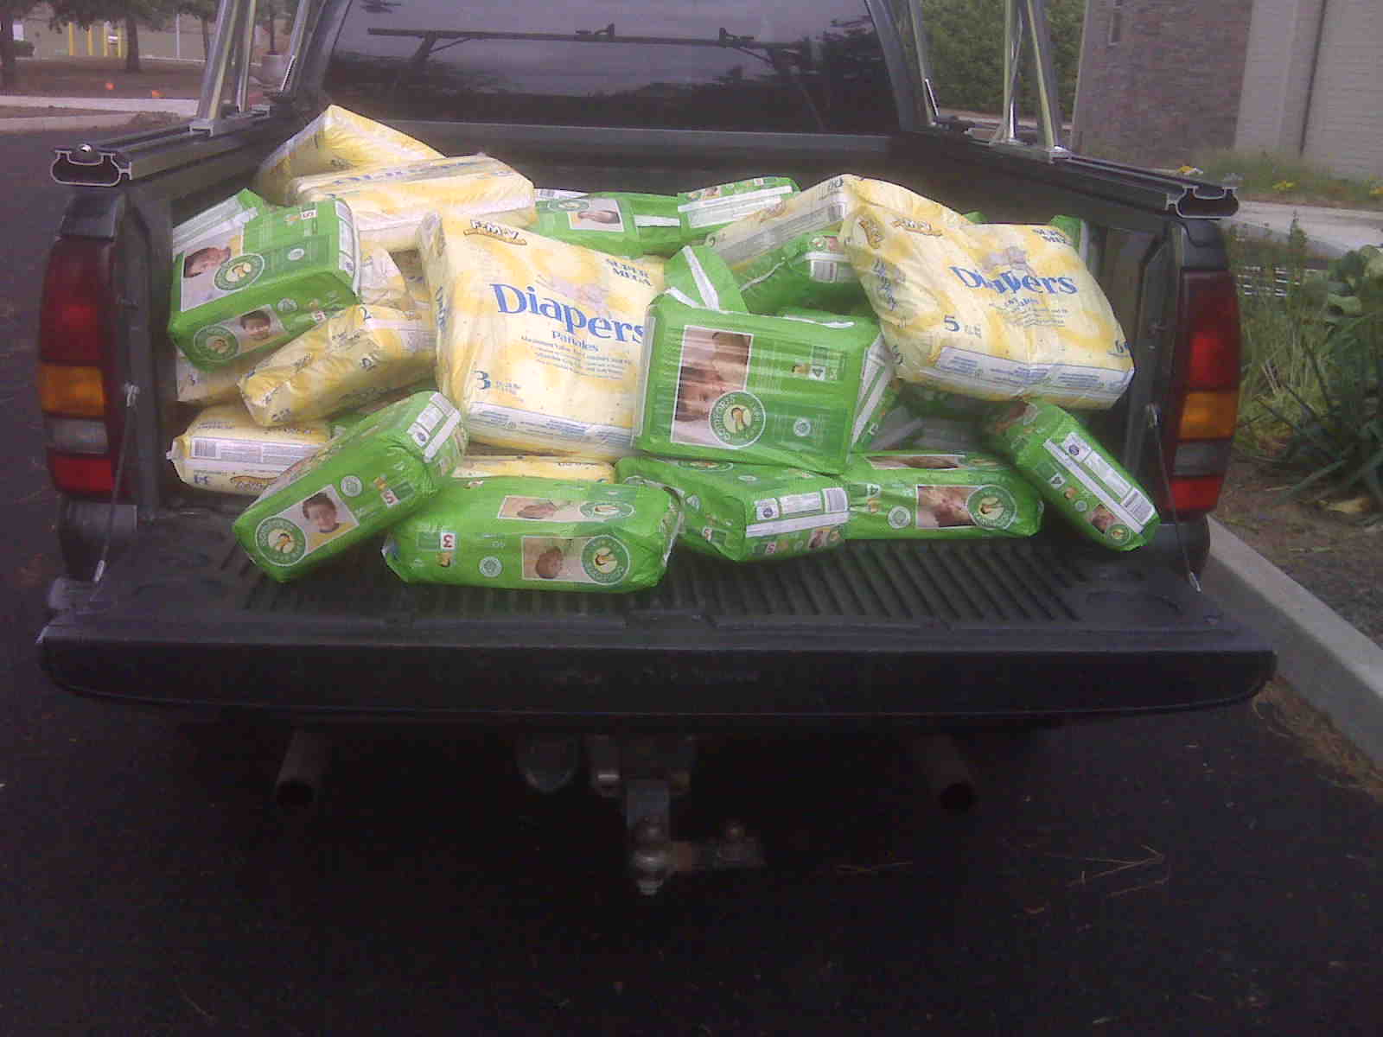
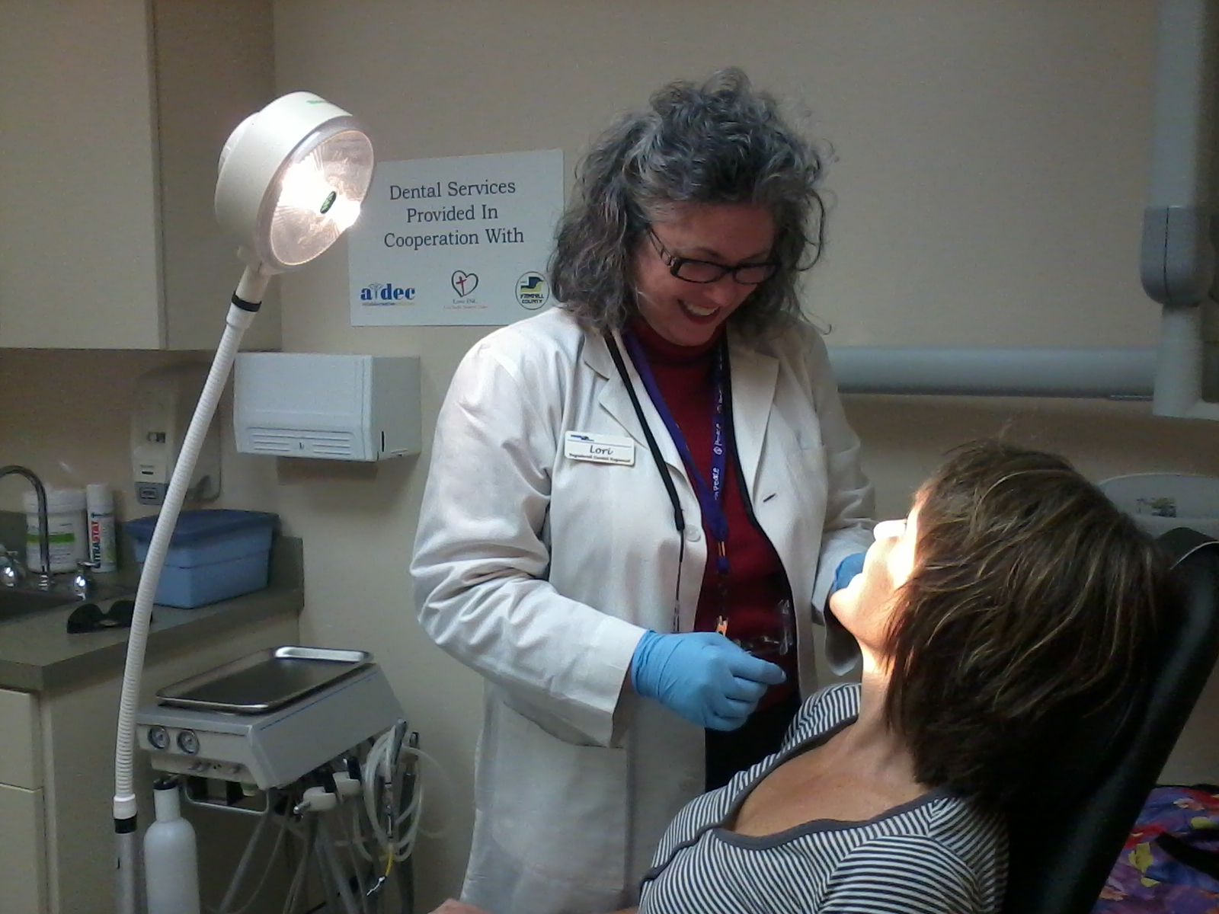
Love INC Programs
Clearinghouse
Gap Ministries
  31 Gap Ministries
Newberg Community Shelter
  Women and children
Relational Ministry
  Mentoring
  Money management & life skill classes
Medical/Dental Clinic
  Medical: Vision, hearing, health exams
  Dental: Cleaning and restorative clinics

Slide 16
How to Refer to Love INC?
Schedule an intake by calling 503-537-3999 Tuesday through Thursday from 9am-2pm
209 S Main Street
Newberg, OR 97132
503-537-3999

Slide 17
Fostering Hope Initiative
Children. Families. Neighbors
Imagine…
…every child and youth
in every neighborhood
lives in a safe, stable, nurturing home,
is healthy, succeeds at school,
and goes on to financial self-sufficiency.
Notes:
17

Slide 18
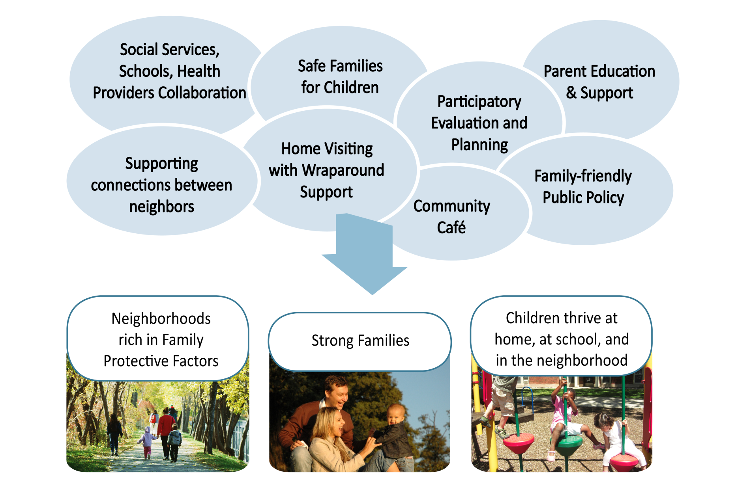
Promoting Optimum Child & Youth Development
Notes:
18

Slide 19

Fostering Hope Initiative
Children. Families. Neighbors
Tedra Stuart, Project Director
tstuart@ccswv.org
503-856-7002
Lead Partner

Slide 20
Faith in Action
Creating Caring Connections
An outreach of Providence Newberg Medical Center

Slide 21
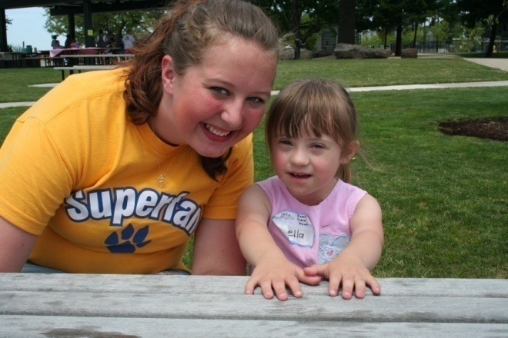

Faith in Action Family Friends Program
One on one volunteer mentors for children, ages 0-10, who have a disability or chronic health condition and live in Newberg, Dundee or Sherwood
Family Caregiver Support Group
Summer Fun Day
Kid’s Day Out– a respite opportunity for families and fun day for kids.

Slide 22
How to refer to Family Friends?
Contact Deana VandenHoek
503-537-1471 deana.vandenhoek@providence.org
310 Villa Road, Suite 110
Newberg, OR 97132
www.faithinactionnewberg.org

Slide 23

Who we are
MARION, POLK & YAMHILL COUNTIES
Notes:
23

Slide 24
Child Care Resource
& Referral
CCR&R connects parents to local quality child care professionals.
Educates parents with personalized assistance on how to choose quality child care.
Connects and navigates families to community programs and to sources of financial assistance for child care.
CCR&R connects and educates child care professionals by offering multiple free and low cost trainings.
Offers support for providers in navigating the child care system and improving quality environments.

Slide 25
How to refer to CCR&R?
Call 503-585-2491 or 1-800-289-5533
Monday – Friday
9am – 5pm
2475 Center St. N.E.
Salem, Oregon 97301
Email: CCIS@MWVCAA.org
www.mycommunityaction.org

Slide 26
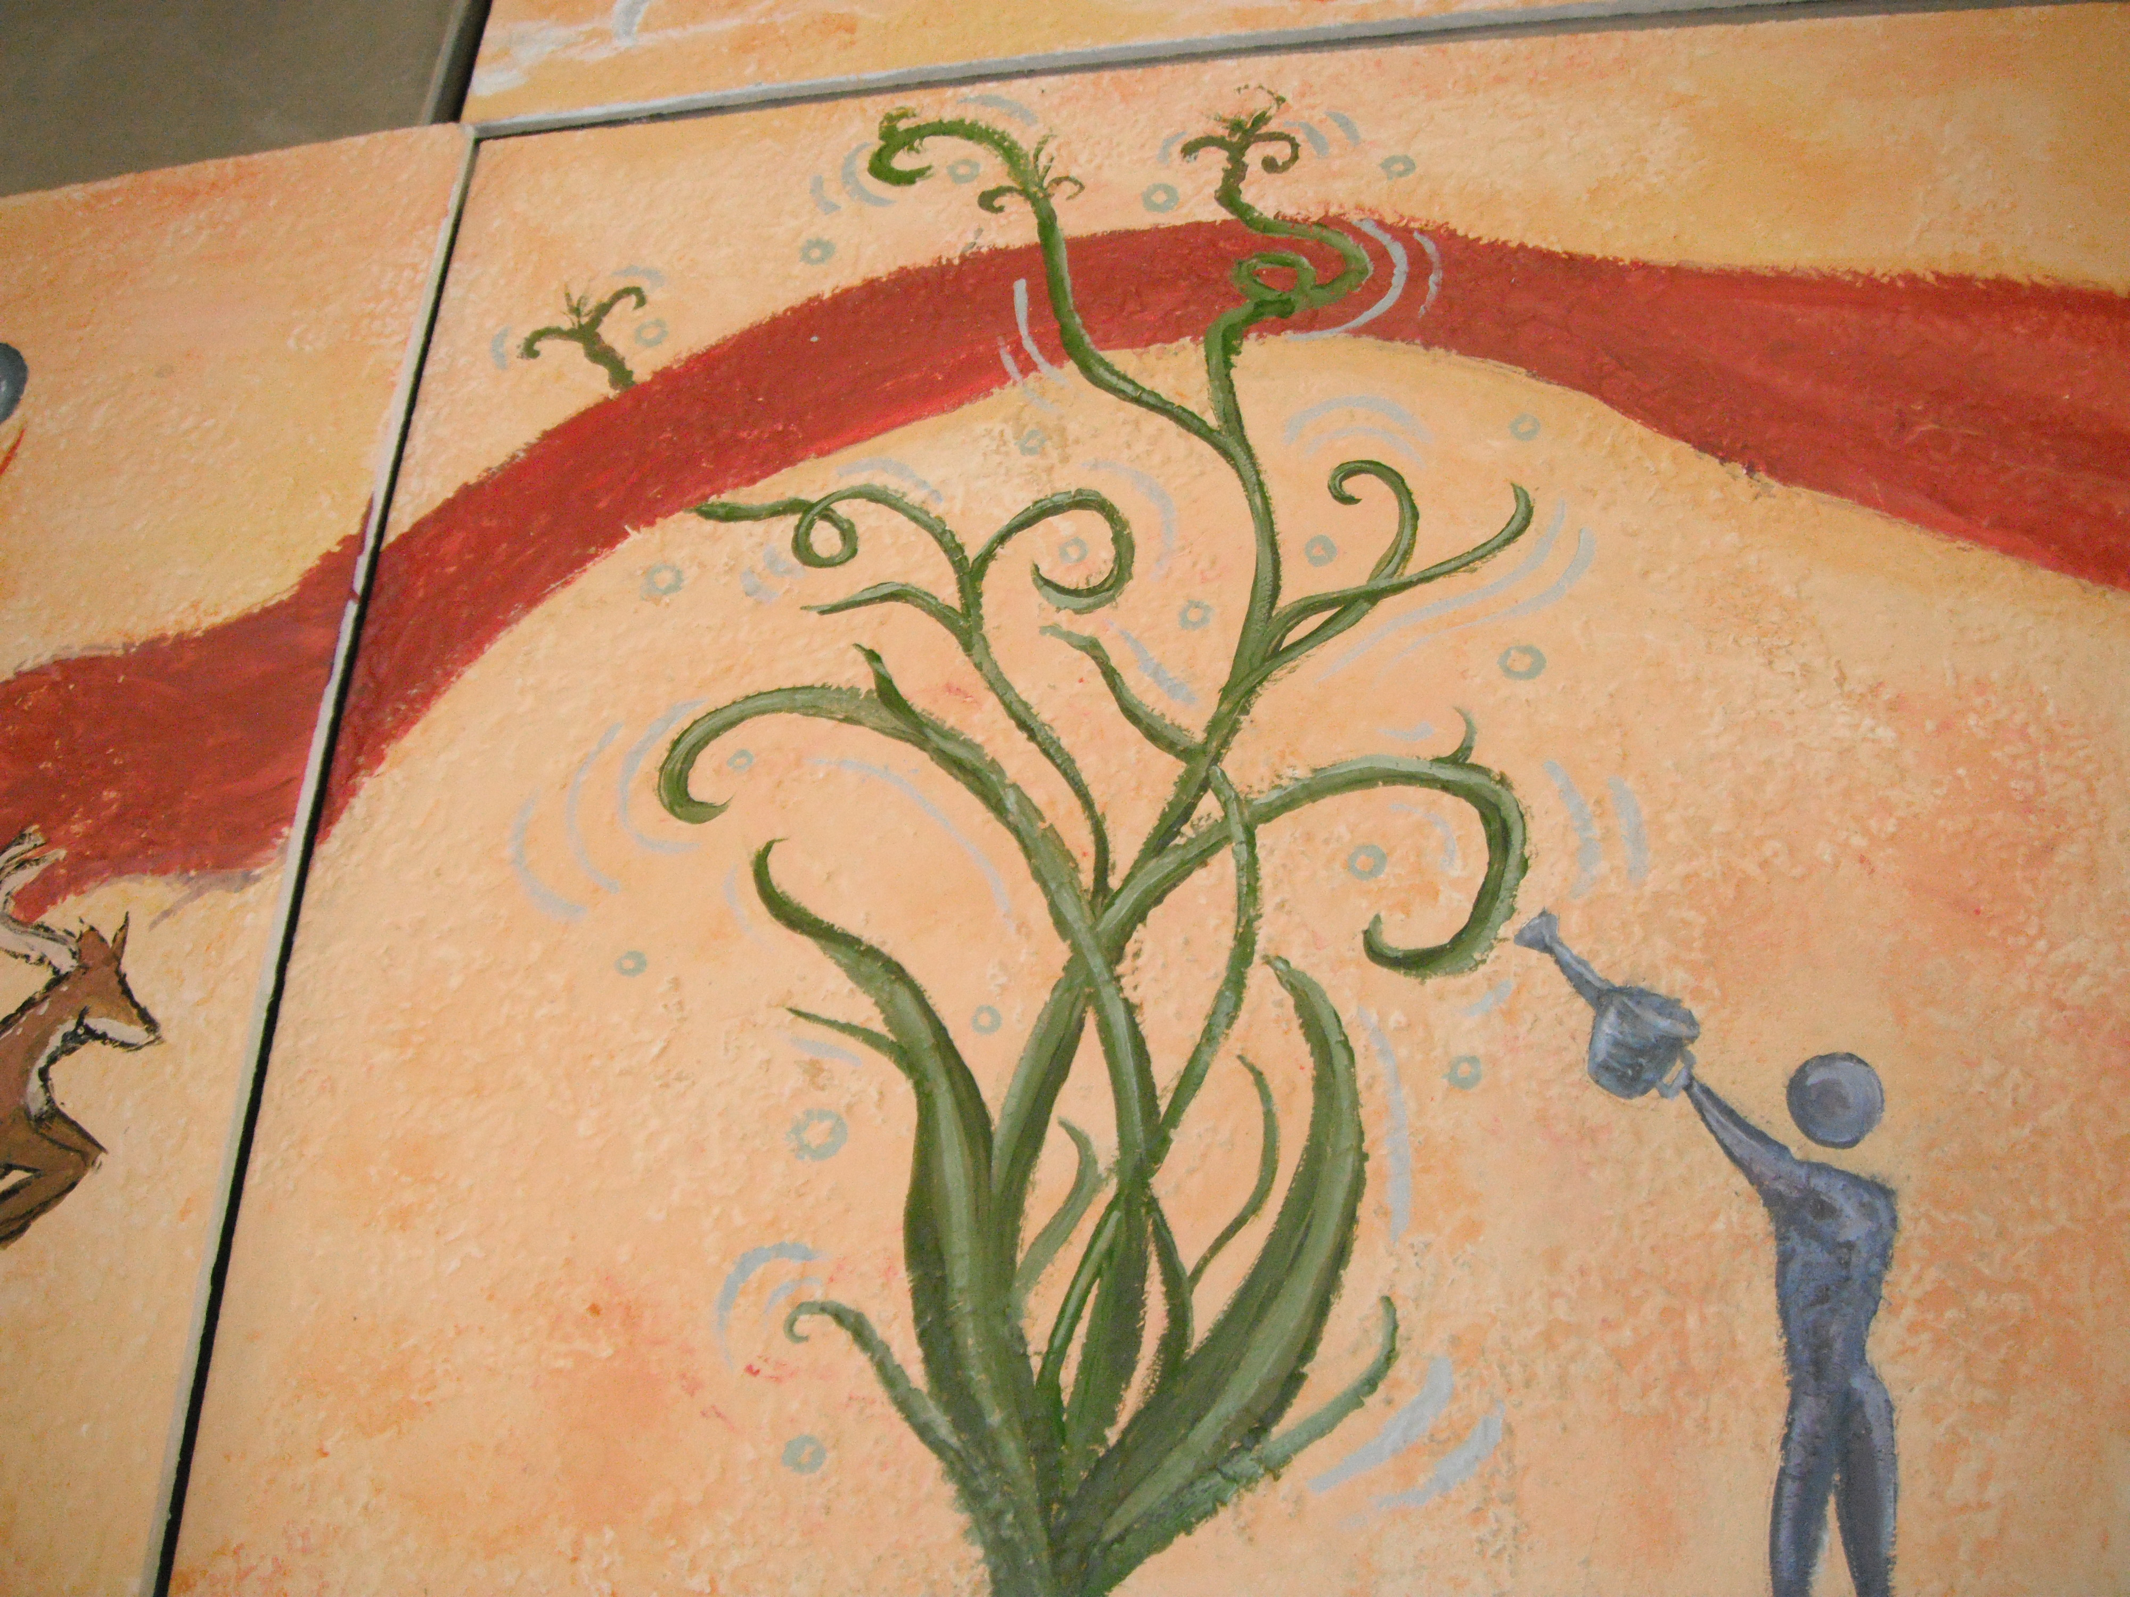

Who We Are
Serving Yamhill County Since 1983

Slide 27
LCS Programs for Children 0-5
      Mothers and Babies Course
      Targeting mothers of children prenatal to 3 at risk for developing post partum depression. Food, childcare and transportation are provided
      Strengthening Families Program
      We offer over 20 parenting class throughout the county. These evidenced-based classes reduce negative social indicators (chemical dependency, dropout rates, conduct disorders, juvenile delinquency) in children whose parents take the class. Food, childcare and additional incentives may be provided
      Parenting Traumatized Children Seminar
      Designed to equip caregivers of children who have experienced trauma with skills and strategies to support the child’s unique needs.

Slide 28
LCS Programs for Children 0-5
  Family and individual counseling
  Medication management
    Our multi-disciplinary team, including Child Psychiatrists, Psychologists, and mental health therapists work with a variety of family and mental health disorders. We coordinate our services with Primary Care providers whenever possible.

Slide 29
How to Refer?
We provide prevention services and mental health counseling covered by OHP.
All parenting classes are free of charge
Call our office or fax over a referral form
617 NE Davis St.
McMinnville, OR 97128
Phone: 503) 472-4020
Fax: (503) 472-8630

Slide 30

Yamhill County Health & Human Services
Family & Youth Programs
Counseling for Children, Youth and Families
Screening, assessment and treatment
Services in Newberg and McMinnville

Slide 31
Yamhill County Health & Human Services
Family & Youth Programs
Mental health therapy for children and their families
  with Oregon Health Plan insurance
  Collaborative Problem Solving (CPS)
    support for parents through classes and groups/Newberg & McMinnville
Drug and alcohol services
  Groups and individual services; family support
Parent-Child Interaction Services (PCIT)
  Parent coaching with child for children with behavior issues for ages 2 – 7

Slide 32
Yamhill County Health & Human Services
Family & Youth Programs
How do you Refer?
We provide mental health services covered by OHP and some private insurances.
Call our office to schedule an intake
Two locations:
        McMinnville Office: 420 NE Fifth Street
        Newberg Office: 2251 East Hancock Street
        Phone: (503) 434-7462 (503) 538-8970
Notes:
Target audience is Newberg parents
32

Slide 33
First Step
Adolescent Center
120 A North Everest Rd. Newberg OR. 97132
503-538-7647 www.fsac.net
Adolescent specific
substance abuse/ addiction treatment
A healthy lifestyle through recovery

Slide 34
Services
MIP diversion class
Level 1 outpatient treatment
Level 2 intensive outpatient treatment
Parent support group 3rd Sunday of each month from 4:00 to 5:30 (this is a free service. For more information refer to the website www.fsac.net)
Individual - group - family therapy
Oregon Health Plan and most private/group health insurance accepted

Slide 35
First Step
Adolescent Center
120 A North Everest Rd. Newberg OR 97132
503-538-7647 www.fsac.net
To schedule an initial evaluation please contact
our main office at 503-538-7647.

Slide 36
Who we are
Valley Women’s Health
Women’s Health Care
Willamette Valley Medical Center
McMinnville, OR

Slide 37
Services
Obstetrical Care
  Prenatal Care, Low risk and High risk deliveries, midwifery care and cesareans
Well-Woman Care
  Adolescent Care, Menopausal Care, Gynecological Care, Contraception, Incontinence, PCOS, Endometriosis, STD testing/treatmet
Surgical Care
- Hysterectomy, Ablation, Tubal Ligation, & more

Slide 38
How to refer to
Valley Women’s Health
Accepting new patients including OHP and Tricare!
Call: 503.474-1148
Check out our new website:
www.vwhmcminnville.com
Evening appointments available!

Slide 39

Committed to supporting
safety,
wellness and dignity
for all
Notes:
Tried to spice it up with Word Art…if you don’t like it, don’t use it ☺
39

Slide 40
  Home Visiting Programs
    Our home visiting programs connect families to community resources, provide weight checks and information about topics such as parenting, safety, nutrition, breastfeeding and child development
    Home visiting services are provided at no cost to families
  Post Partum Depression Program
    A 12 week series of meetings for Spanish speaking women with a child under the age of two years. Transportation is available . This service provided at no cost to families
  Immunizations
    Adult and child immunizations provided on a sliding scale based on household size and income. We are also able to bill OHP and private insurances
  Family Planning
    Available to prevent pregnancy and encourage healthy pregnancy spacing
    Services available on a sliding scale based on household size and income
Notes:
BJC: I made the fonts a bit smaller and changed some of the words, like “things” became “topics”.
I made “to the family” into “families” to be consistent with wording, same with “household size and income.
Do you want to say anything about children’s immunizations may be covered by insurance or OHP?
40

Slide 41
How do you Refer?
You or your provider can reach us by calling our office or faxing a referral for our home visiting programs and postpartum depression program
Appointments for any other services can be made by calling our office
412 NE Ford Street
McMinnville, OR 97128
Phone: 503-434-7525
Fax: 503-472-9731
Notes:
If this presentation is directed at parents, can they refer themselves? I removed “or email” because we don’t provide an email address on this slide. I included “You or your provider can reach us by calling or faxing…”
I bolded our phone number, and shrank the font a bit so it looks more like the previous slide.
41

Slide 42

Who we are
Salud WIC Program
    The Special Supplemental Nutrition Program for Women, Infants and Children

Slide 43
Salud WIC
Eligibility
  Live in OR (legal status not required)
  Pregnant and postpartum (up to 1 year) women, infants, and children up to age 5
    Fathers, grandparents, foster parents and other guardians may apply for WIC for their children
  Income (185% Federal Poverty Level)
    Family of 4: $3446/month (gross income)
    Adjunctively income eligible if also participating in OHP, SNAP and/or TANF
Benefits
  Nutrition education
  Breastfeeding education/support (including breast pumps
  Vouchers for healthy foods
  Infant formula for infants who are not breastfeeding

Slide 44
How to refer to Salud WIC?
Call our office or walk-in
2251 E Hancock St, Suite 107
Newberg, OR 97132
503.538.8779
Toll Free: 855.wic.wic0 (855.942.9420)
Fax: (503) 538.6970
Open weekdays 8 am-5 pm
Closed daily for lunch from 12-1
We also have clinics in McMinnville, Woodburn and Salem

Slide 45

Who we are…
Uniting people and resources for a stronger community.

Slide 46



United Way Initiatives…
During the 2009/11 cycle, the United Way of the Mid-Willamette Valley funded 63 programs within 46 agencies in Marion, Polk and Yamhill Counties. We also support three important initiatives:

Slide 47
How to get involved…
To find out more about the United Way and our funded partners, check out the Web site at: unitedwaymwv.org
For information and referral dial: 2-1-1
  Or access the Web site at: 211info.org
To volunteer go to: handsonmwv.org

Slide 48
Who we are
Housing Authority of Yamhill County (HAYC)
Notes:
48

Slide 49
HAYC Programs
Section 8 Rental Assistance and Associated Programs
Family, Senior, Disabled, and Farmworker Housing
Credit/Budget and Homeownership Counseling
Home Retention Counseling/Programs
Homebuyer and Financial Literacy Education
Housing Rehabilitation Loans
Information and Referral

Slide 50
How to refer to HAYC?
Call or stop by our office during regular
business hours Monday to Friday 8am-5pm
135 NE Dunn Place
McMinnville OR 97128
Phone: 503-883-4300
Fax: 503-472-4376
Toll free in Yamhill County: 888-434-6571
Or visit us online at
www.hayc.org

Slide 51



Your Community Mediators
of Yamhill County
PEACEBUILDING OPTIONS
FOR YOUTH & FAMILIES
Notes:
51

Slide 52
Types of Family Mediations. . .
Divorce and separation issues
Elder issues, family estate distributions
Juvenile Victim/Offender restitution & apology
Parent/Adolescent concerns
Parenting Plan updates & custody issues
Other family concerns . . .
a healing damaged relationships
a planning for a disabled child
a blended family concerns, etc.
Notes:
52

Slide 53
Steps to Request a Mediation . . .
VISIT YCM website for info: www.ycmediators.org
2. CONTACT YCM by phone or email: 503-435-2835
ycm@macnet.com
3. DISCUSS your conflict confidentially with YCM staff
4. REQUEST that a “letter of invitation to mediation”
be sent to other party
Empowering people to make positive changes
YCM MISSION:
in the way they respond to conflict
Notes:
53

Slide 54
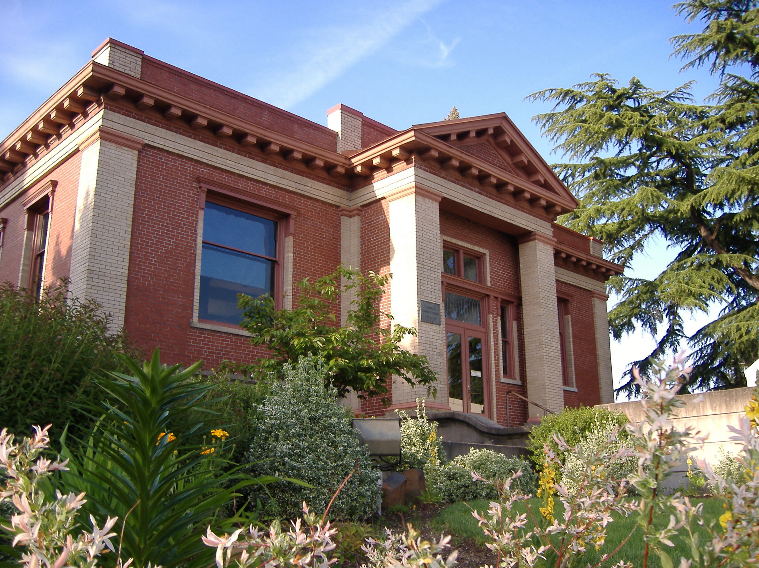


Slide 55

Library Programs (no charge)
Early Literacy Storytimes
Trained Children’s Librarians offer weekly educational storytimes for children birth – preschool age.
Special programs offered quarterly or more.
Free monthly movies (with popcorn).
Book clubs for 1st – 5th graders held monthly.
Summer Reading Program (free book & prizes) June 6th – Aug. 29, 2012.

Slide 56
Where to find the
Newberg Public Library
www.newberglibrary.org
facebook.com/newberglibrary
nplibrary@newbergoregon.gov
503 538 7323
503 E. Hancock Street
Newberg, OR 97132

Slide 57
WESD EARLY INTERVENTION (EI)
What is early intervention?
Children who receive early intervention services range in age from birth to three years of age need to meet eligibility criteria and demonstrate a need for services because of a significant delay in one or more areas of development, including cognitive, physical, communication, self-help, social development; or
meet eligibility criteria for vision or hearing impairment, autism spectrum disorder, orthopedically impaired, traumatic brain injury; or
for very young children, eligibility for services can be determined on the basis of a medical diagnosis of a condition likely to result in a developmental delay.

Slide 58
EARLY CHILDHOOD SPECIAL EDUCATION(ECSE)
What is early childhood special education?
Children who receive early childhood special education range in age from 3 years to entry into public kindergarten.
Children need to meet eligibility criteria and demonstrate a need for services because of a significant delay in two or more areas of development, including cognitive, physical, communication, self-help, social development; or
meet eligibility criteria for a school age eligibility such as communication disorder, other health impaired, emotionally disturbance, vision or hearing impairment, autism spectrum disorder, orthopedic impaired, traumatic brain injury
Children in early childhood special education programs
have disabilities that range from mild to severe.

Slide 59
What services does Oregon provide to children and families?
  Programs are specially designed to address the special education needs of young children with disabilities.
Services may include:
  Providing the family with specific information about the child’s delay;
  Incorporating the child’s special needs into family routines within the home or within the daily routines within a preschool program;
  Connecting the family to community resources;
  Coaching parents, family and caregivers on specific child skills.
Services may include a single service or a combination of the following:
Evaluation Developmental consultation/education Parent consultation/education Physical or occupational therapy Speech/Language therapy Behavior Services | Vision services Hearing services Augmentative communication Autism Spectrum Disorder Services Assistive technology Services

Slide 60
How to refer to EI/ECSE?
Marion/Polk/Yamhill Counties
Marion/Polk County Referral Line: 503-385-4714
Polk/Yamhill County Referral Line: 503-435-5918
Fax: 503-435-5923
Referral/Evaluation Coordinator: Devora Gramson
Program coordinators: Devora Gramson @ 503-385-4651 or 503-435-5941
devora.gramson@wesd.org
Debbie King @ 503-385-4512
debbie.king@wesd.org

Slide 61
Q & A
Do you have any questions for our resource providers?
Thank you for attending!

